Slide 1
Statistical Analysis of Major league baseball
By Nikhil Deo

Slide 2
Dataset
Maximal Information-based Nonparametric Exploration (MINE)
How to approach multi-dimensional datasets
Broad Institute of MIT and Harvard
Practice Datasets:
World Health Organization (WHO)
Gene Expression
Microbiome
Baseball

Slide 3
MLB2008.csv
I chose the baseball dataset – MLB2008.csv
Contains statistics for every MLB player for the 2008 season
Does not include pitchers or pinch runners
Includes data for:
132 different statistics
337 different players
In total: ~45,000 cells with just data

Slide 4
Baseball and sabermetric
Sabermetrics – statistical analysis of baseball and its players
Started by the Society for American Baseball Research (SABR)
Primarily used to compare individual players
This project uses sabermetrics to look at trends by position and statistical category

Slide 5
My questions
Which statistic is most correlated with salary?
Which position is the best offensively?

Slide 6
Question 1 - method
Ran a pearsonr test on each statistic compared to salary
Created a dictionary with each statistic and their correlation coefficients
Found the most correlated statistic to salary

Slide 7
Question 1 - results
The most correlated statistic to salary: BB
BB – Bases on Balls
The number of walks intentionally or accidentaly

Slide 8
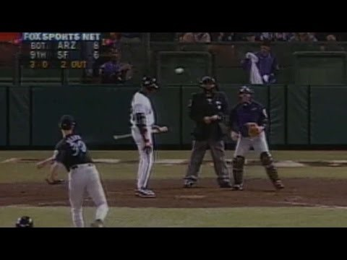
Intentional walks

Slide 9
Bases on balls
In baseball, runs = wins
A player who can get runs is a threat to other teams
A player who essentially guarantees wins to the other team would:
Be a risk worth avoiding
An asset to the other team worth paying a lot of money

Slide 10
Correlation
The correlation coefficient between BB and salary: 0.404
Not especially strong
Still a correlation
What does the mild-strength correlation indicate
Good batting is heavily valued
Not the only things valued

Slide 11
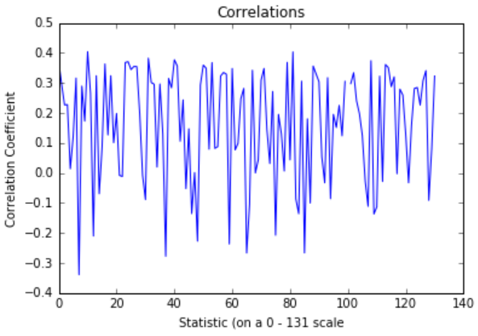
Correlations

Slide 12
Question 2
What position bats the best?

Slide 13
Question 2 – Method
Created a metric to judge batting proficiency
Analyzed each player on that metric
Divided each metric value by position
Found each positions mean
Found the highest mean

Slide 14
My Metric
Average of a player’s batting average, slugging percentage, on-base percentage
Batting average: hits/at-bats
Slugging percentage: hits/at-bats weighted by base (triples > doubles)
On-base percentage: hits, BB, HBP/at-bats
Combination of most telling batting statistics
Weights quality of hits
Weights perceived quality of batter

Slide 15
Question 2 - Results
Position with the highest metric value mean: First Base
Traditionally power hitters
Would likely have high slugging percentages, BB’s, etc.
Same build and role as DH, less pressure

Slide 16
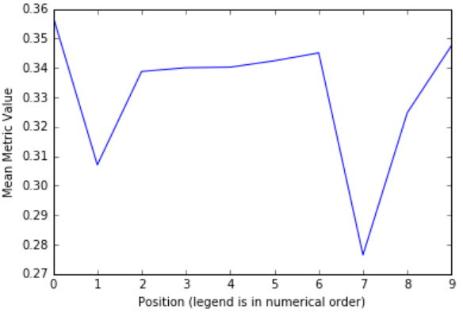
Means
Notes:
Legend:
First Base
Catcher
Left Field
Third Base
Center Field
Designated Hitter
Second Base
Pinch Hitter
Shortstop
Right Field

Slide 17
Findings
The most correlated statistic to salary: Bases on Balls
Players who are walked are good batters
So good they are essentially guaranteed runs
The position with the best batting: First Base
Traditionally power hitters
Power hitters have high slugging percentages and BB’s
Both major factors in the offensive metric

Slide 18
Bibliography
D-backs Walk Bonds with the Bases Loaded. Dir. MLB. Perf. Barry Bonds and Johnny Oates. YouTube. YouTube, 27 May 2015. Web. 30 Mar. 2016.
"Home | MINE: Maximal Information-based Nonparametric Exploration." Home | MINE: Maximal Information-based Nonparametric Exploration. Broad Institute. Web. 31 Mar. 2016.
"Interview of Thomas Butler." Personal interview. 30 Mar. 2016.
SABR. "Sabermetrics." Sabr.org. Society for American Baseball Research. Web. 30 Mar. 2016.

